Slide 1
Ch-6 COMMON MECHANISMS
The UML is made simpler by the presence of four common mechanisms that apply consistently throughout the language: specifications, adornments, common divisions, and extensibility mechanisms.

Slide 2
  Notes:-
Graphical symbol for rendering constraints or comments attached to an element or collection of elements.
No Semantic Impact: does not alter the meaning of the model.
Specify things like: Requirements, Observations, Reviews, Explanations, Constraints

Slide 3
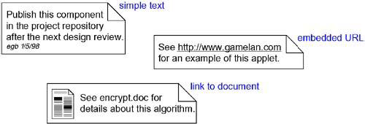
Notes

Slide 4
Adornments:-
Adornments are textual or graphical items that are added to an elements basic notation and are used to visualize details from the elements specification.
Placed near the element as
  Text
  Graphic
Special compartments for adornments in
  Classes
  Components
  Nodes

Slide 5
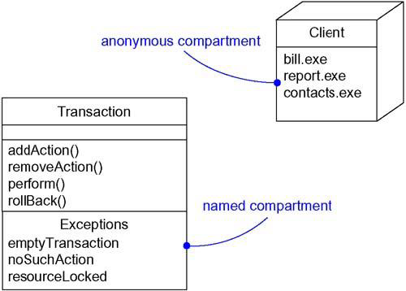
Extra Compartments

Slide 6
Stereotypes:-
A Stereotype is a metatype, because each one creates the equivalent of a new class in the UML’s methodology.
Named stereotype
Named stereotype with Icon
Stereotype element as Icon

Slide 7
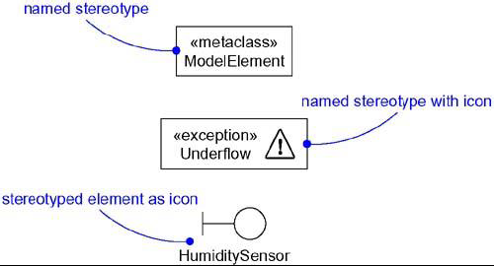
Stereotypes

Slide 8
Tagged Values:-
Tagged values add new properties.
A tagged value is not the same as a class attribute. Rather, you can think of a tagged value as metadata because its value applies to the element itself, not its instances.

Slide 9
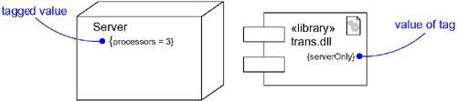
Tagged Values

Slide 10
Constraints:-
Constraints add new semantics or change existing rules.
A constraint specifies conditions that must be held true for the model to be well-formed.

Slide 11
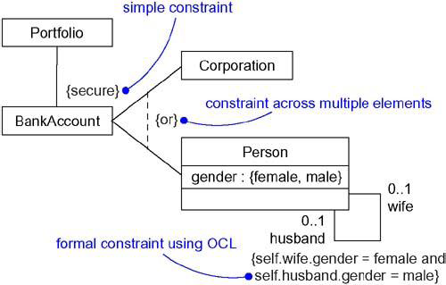
Constraint

Slide 12
Common Modeling Techniques
Modeling Comments
To model a comment:-
Put your comment as text in a note and place it adjacent to the element to which it refers. You can show a more explicit relationship by connecting a note to its elements using a dependency relationship.
Remember that you can hide or make visible the elements of your model. This means that you don't have to make your comments visible everywhere the elements to which it is attached are visible.

Slide 13
If your comment is lengthy or involves something richer than plain text, consider putting your comment in an external document and linking or embedding that document in a note attached to your model.
As your model evolves, keep those comments that record significant decisions that cannot be inferred from the model itself

Slide 14
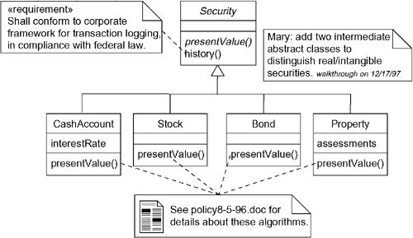

Slide 15
Modeling New Building Blocks:-
Make sure there's not already a way to express what you want by using basic UML. If you have a common modeling problem, chances are there's already some standard stereotype that will do what you want.

